Slide 1
JURISBOX
ASSISTIVE
INTERACTIVE LEARNING
HCI - Educative Team

Slide 2
Jurisbox?
Interactive game
Accompaniment and guidance
facilitate learning about legal terminology
Notes:
Interactive game that provides accompaniment/guidance to children through the legal process of sexual abuse through interactive elements that facilitate learning about legal terminology.

Slide 3
;)
The results so far

Slide 4
Let’s checkout about the first delivery.

Slide 5
THREE CORE USERS
Secondary
Psychologists and child abuse case professionals
Primary
Tertiary
Kids and parents
Despite being red,Mars is actually a cold place
Notes:
As we were guided for a ucd process to develop this project we worked with the analysis and definition of our different users, such as: kids & parents as the primary ones, psychologist as the secondary, and last but not least the legal institutions that could get information about the performance of the primary users so they could take decisions to get better and realize assumptions.

Slide 6
Functional Requirements
01 | The game presents questions related to legal terminology and concepts of sexual abuse.
02 | The game allows the user to select any of the question options.
03 | The game allows the user to select an answer from several options provided.
04 | The game provides immediate feedback on the selected answer, indicating whether it is correct or incorrect.
05 | The game advances once the user has answered correctly.
06 | In case of incorrect answers, the number of answer options will be reduced.
For more info: Check out our github repository provided at the end of the presentation.

Slide 7

Persona
Pablo
Info
Edad: | 9 años
Educación: | Primaria
Ubicación: | Telchac Puerto, Yucatán.
Familia: | Vive con su padres y sus 3 hermanas
Hobbies: | Jugar pesca pesca, ir a pescar con su papá
Metas: | Tener una granja de tilapias
Pablo es un niño de Telchac que disfruta del mar y las actividades al aire libre.

Slide 8
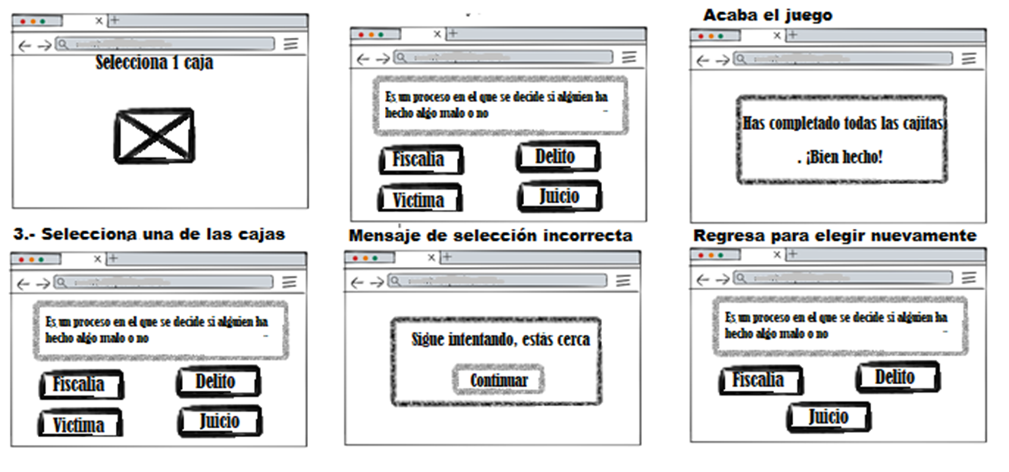
Our first design
Notes:
For the first the delivery we achieved to create a set of mockups by using wireframes, those that helped us to make our first usability tests that will be presented later on this presentation.

Slide 9
Let’s checkout about the second delivery.

Slide 10
Redefinition: Functional Requirements
01 | Presentation of questions.
02 | Selection of question options.
03 | Selection of answer concept description.
04 | Immediate feedback.
05 | Progression.
06 | Reduction of options.
For more info: Check out our github repository provided at the end of the presentation.

Slide 11
Usability Test & Analysis Design
Evaluation
KLM
Defined instruments to facilitate the data collection for a further analysis.
2 game iterations with no failures.
01
Escenario
152s
02
Before test poll
1 game iteration with failure.
03
After test poll
130s
Notes:
The used instruments and the data of our KLM results can be reviewed better on the github repository of the project

Slide 12
WHOA!
Information is good but images are outstanding…

Slide 13
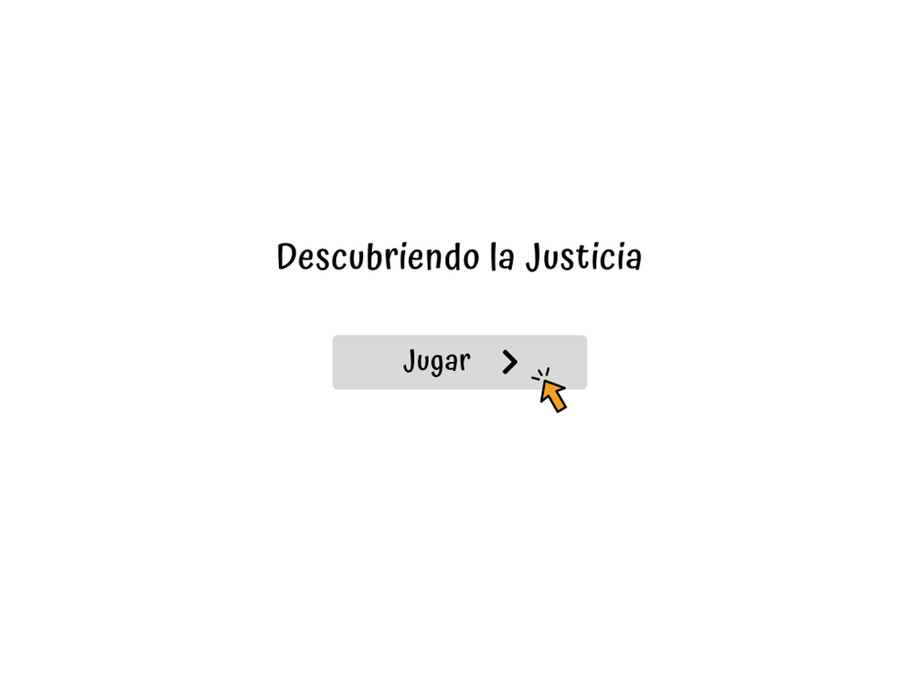
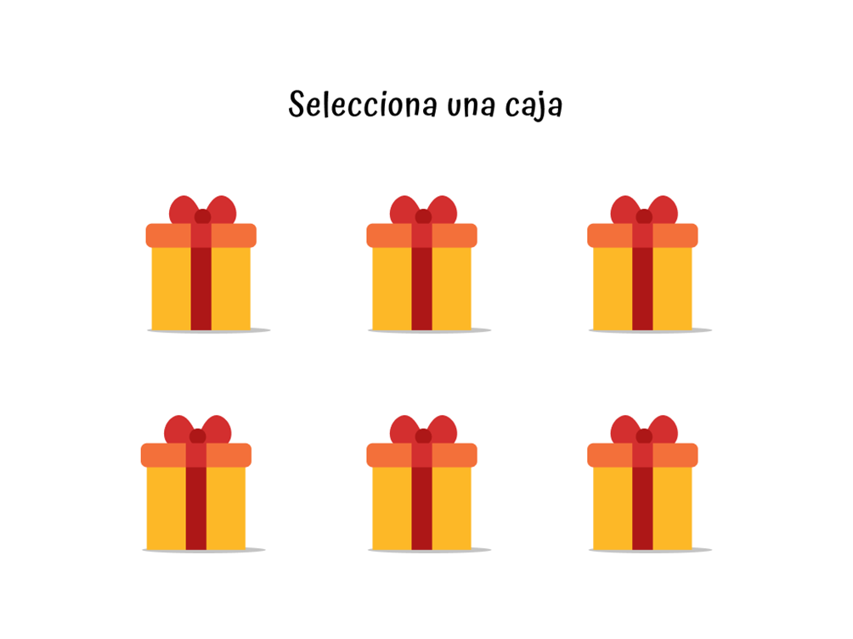
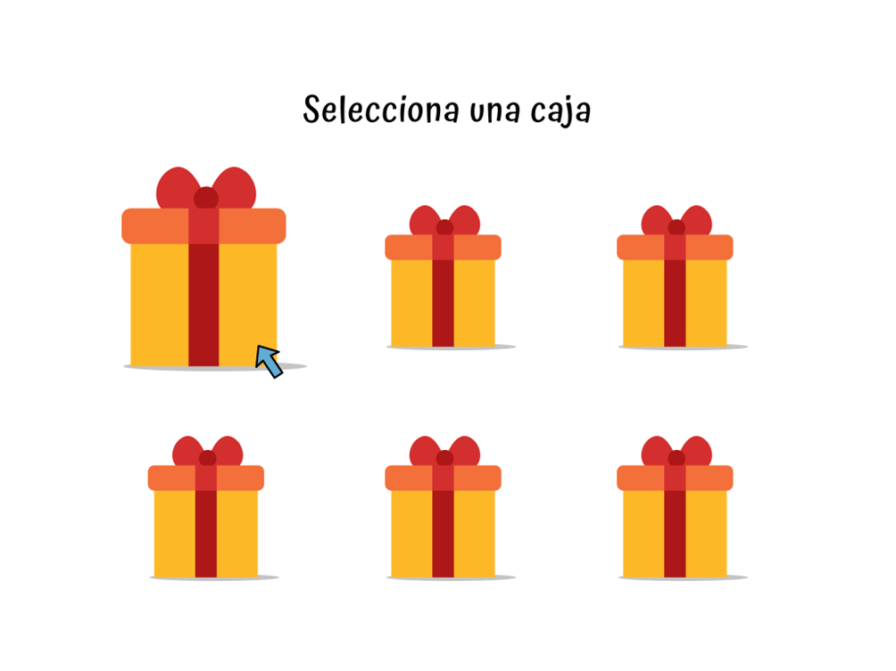
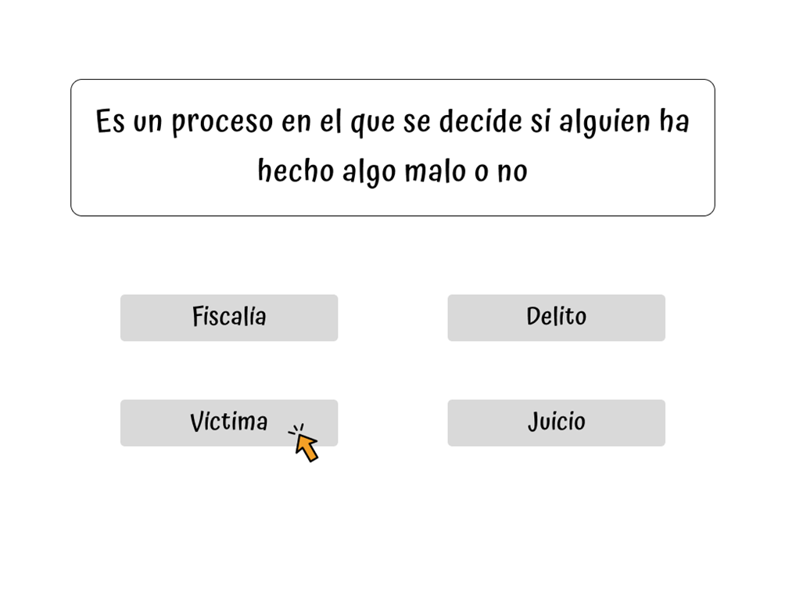
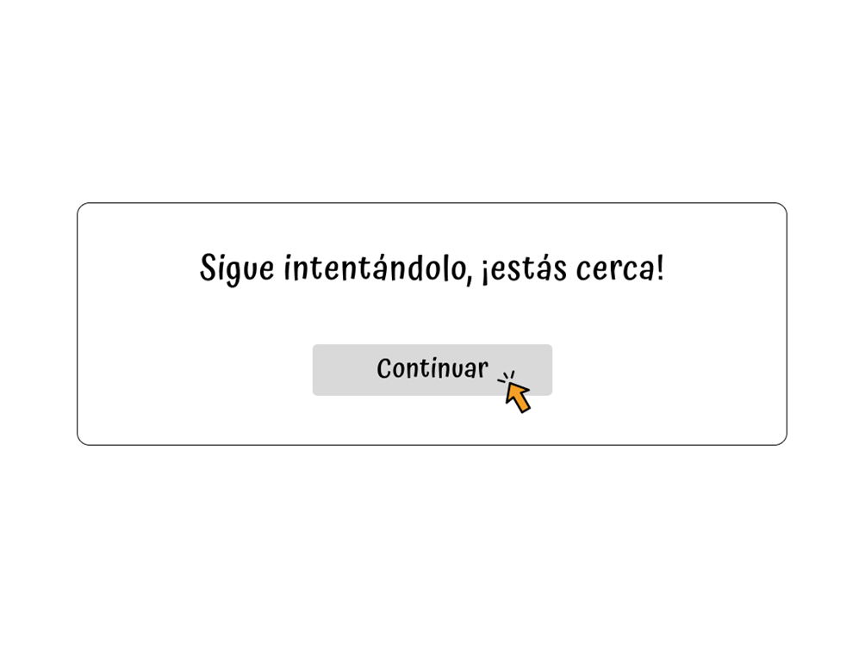
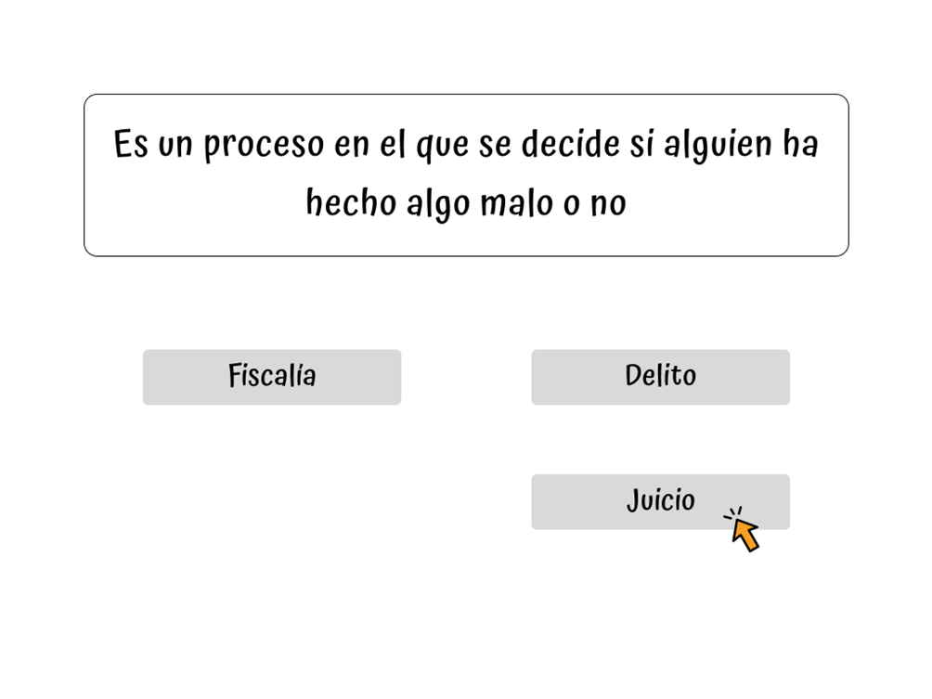
Prototype
Notes:
For the first the delivery we achieved to create a set of mockups by using wireframes, those that helped us to make our first usability tests that will be presented later on this presentation.

Slide 14
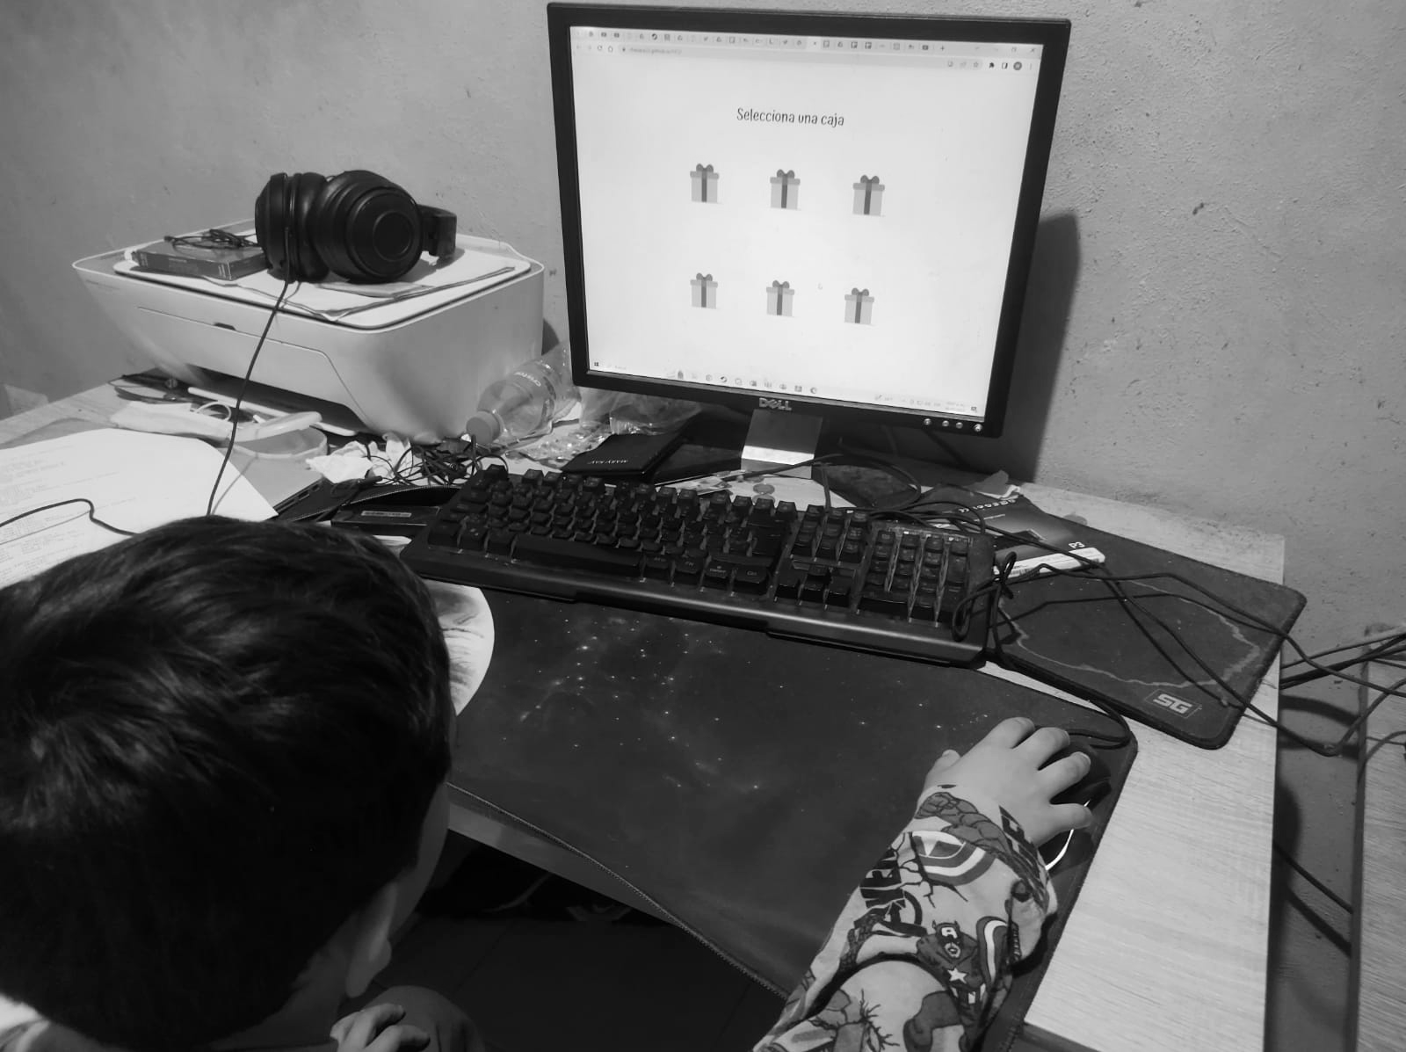
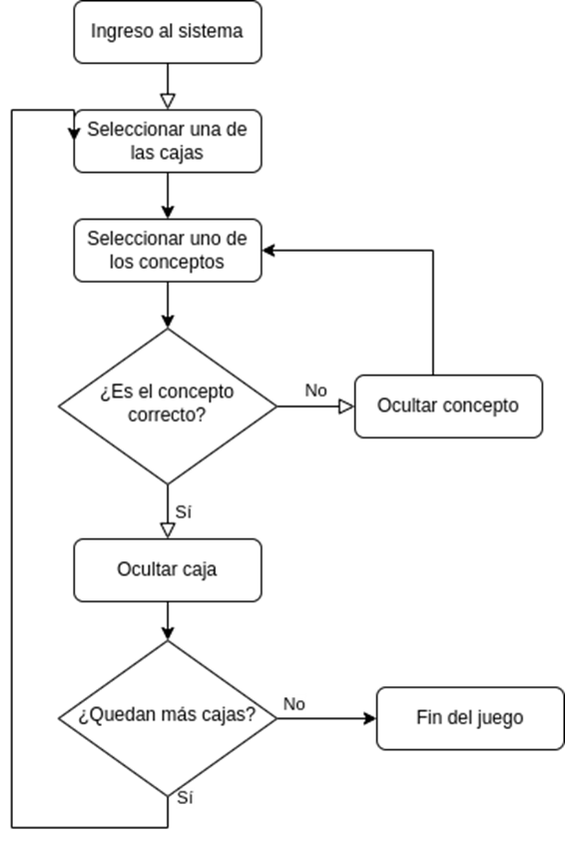
More evidence
01
02
03
Escenarios
Investigation Instruments
Photos of the usability testing
Notes:
As a fast note, i want to say that there is more evidence about the realization of this project that can be reviewed on our github repository.

Slide 15
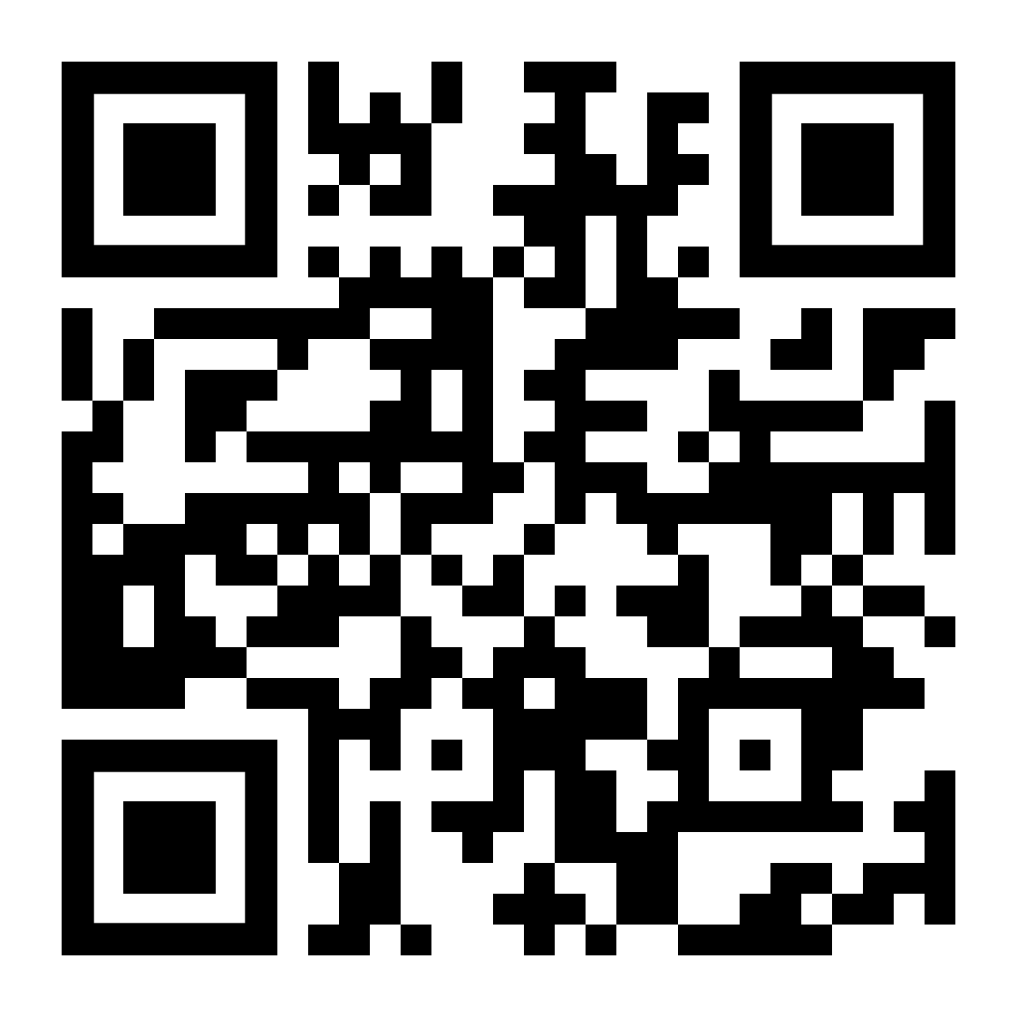
:3
Checkout the demo
https://chesare22.github.io/HCI/

Slide 16
The people and process behind Jurisbox.

Slide 17
OUR PROCESS
At the beginning we created a Gantt Diagram
Inside the team, and a professional. (HCI professor)
Activities
Feedback
Goals
Increment
Defined, reachable and motivating.
Work on previous results.
Get new ones.

Slide 18
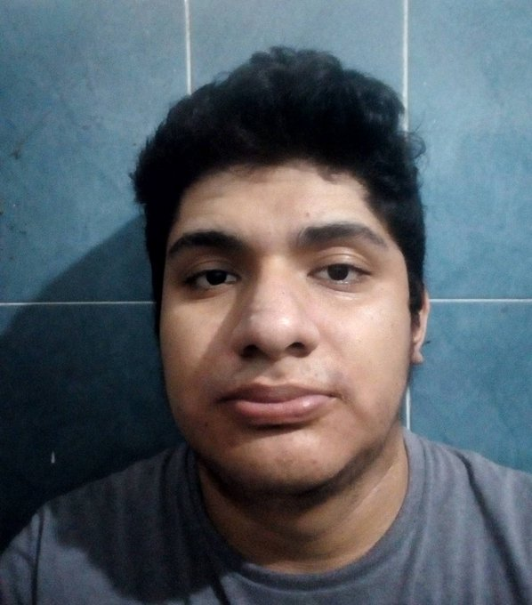
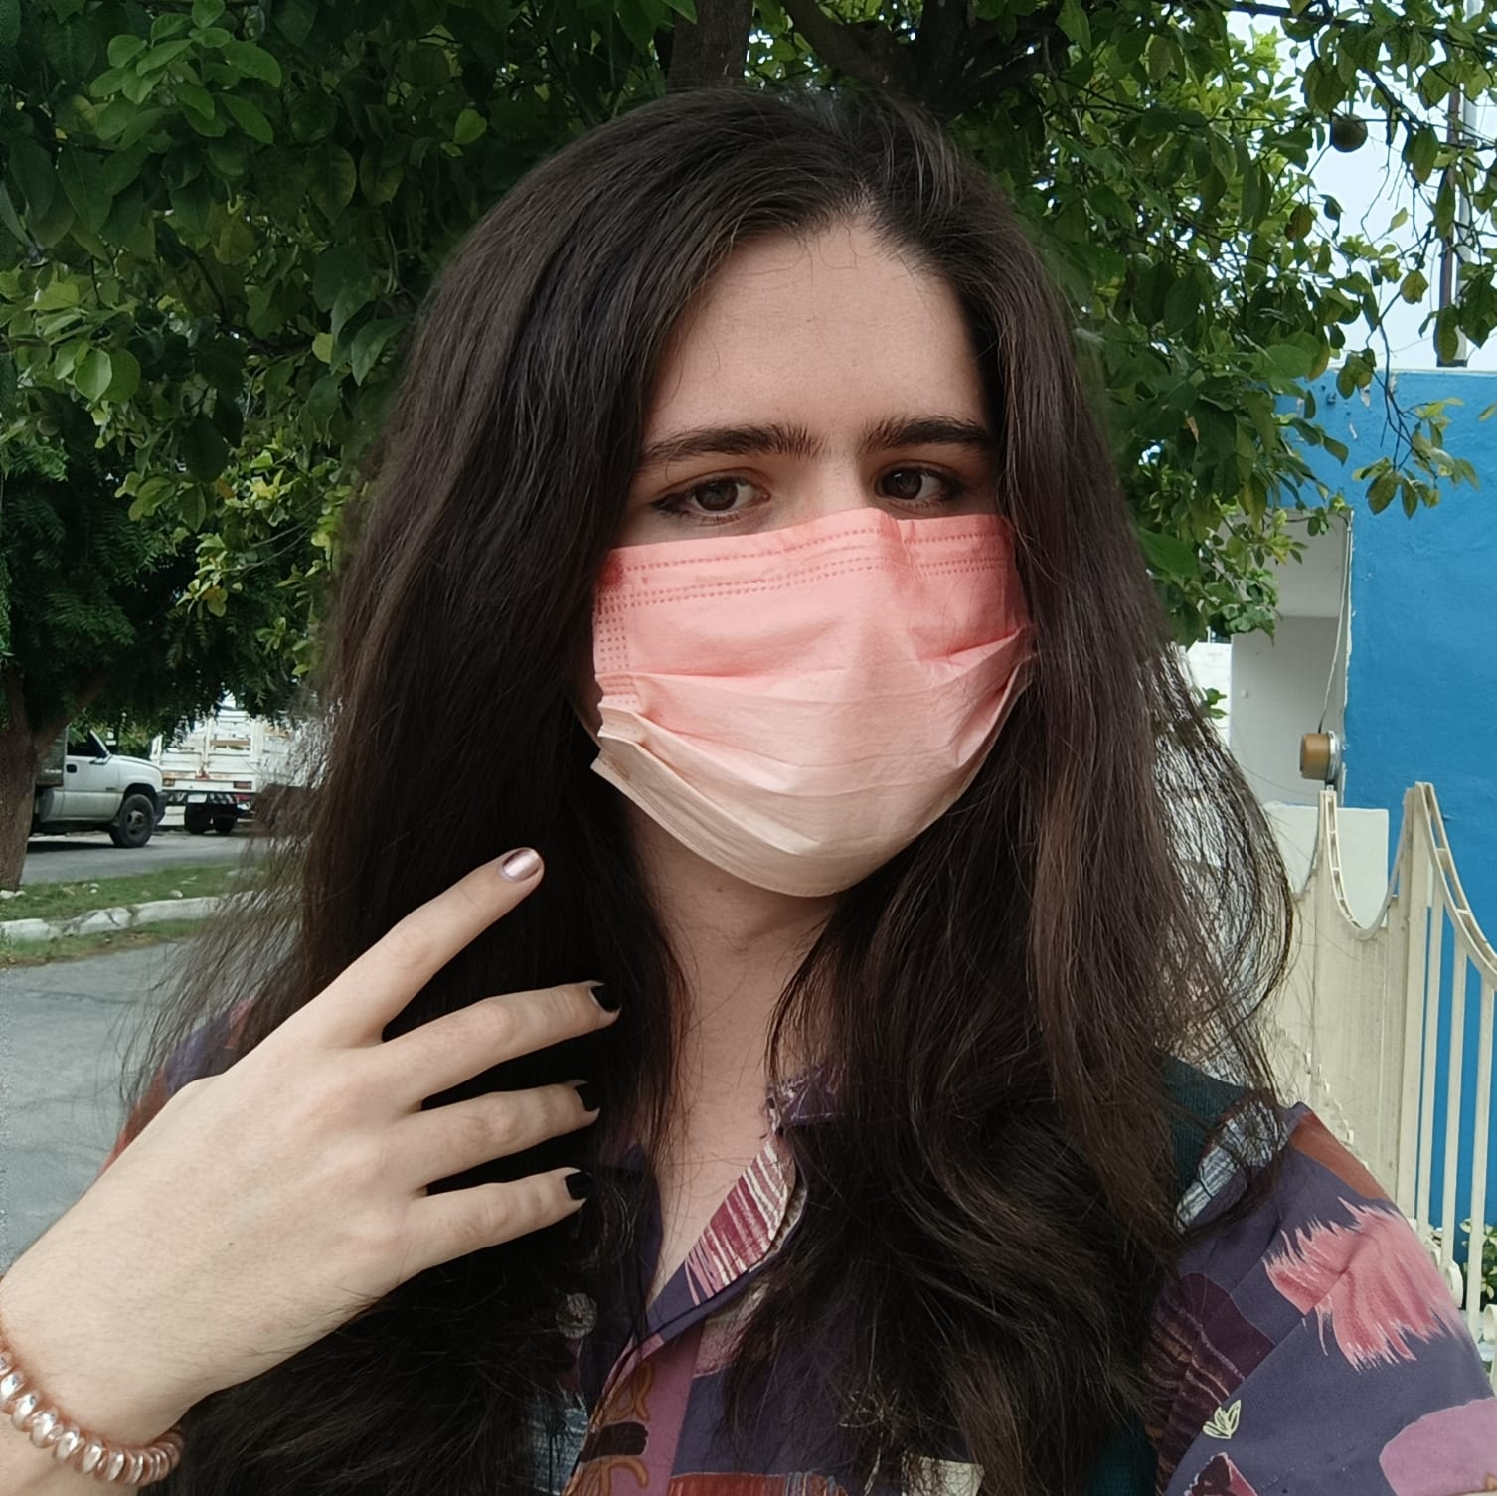
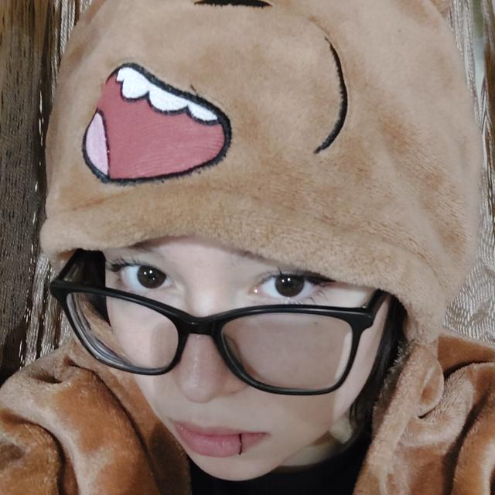

152
345
200
250
Andrés
César
Aranza
Tony

Slide 19
WHAT SETS US APART?
Communication
Whatsapp helped us, but it was not easy at all to communicate all the activities we were working on during the project.
Time
As some of us are working in other projects there were occasions that we could’nt work together due to our personal schedules.

Slide 20
WHOA!
We have reached the end of the presentation…
Thanks for your attention.

Slide 21
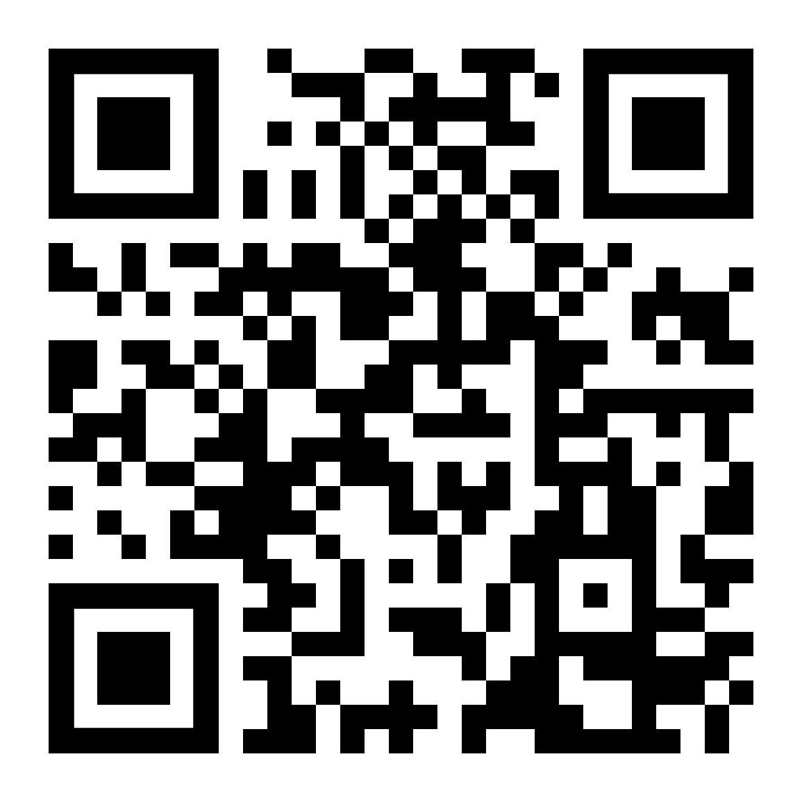
Jurisbox

